Slide 1
CineMates
Movie Ticket Booking
Presented by
Vinit Sunil Chavan
(en20169879@git-india.edu.in)
Yash Ravindra Chawan
(en20140555@git-india.edu.in)
Omkar Vijay Ghorpade
(en20183138@git-india.edu.in)

Slide 2
Introduction
A Java Spring Boot-based movie ticket booking application streamlines the process of reserving seats for movies, offering a convenient and user-friendly experience for cinema enthusiasts. This application encompasses a robust three-layer architecture, comprising controllers, services, and data access objects (DAOs), ensuring efficient data flow.
Users can search for movies based on parameters like movie name, city, and date, which provides a list of available shows. Further, they can access detailed show information and the list of available seats for a particular show. To facilitate booking, the system offers real-time seat reservation, allowing users to select their preferred seats. The booking process takes into account factors like seat availability and overall booking status, ensuring a smooth and secure experience.
By employing Java Spring Boot, this application leverages the benefits of rapid development, robust security, and scalability, making it an ideal solution for the dynamic world of movie ticket bookings.

Slide 3
Features & functionality of the movie ticket booking
Here, the user is presented with a panel displaying sections for Movies, Dates, Theaters, Show Timings, and Seats for selection.
The user can choose a movie and then proceed to select a date, theater, and show timing for booking.
Once these credentials are selected, the user can book available seats, which will turn from white to red after selection.
Seats that appear in grey are non-selectable as they have already been booked.
If booking is unavailable for a particular time, date, or theater, a message will be displayed to the user, suggesting they check for other available date and time.

Slide 4
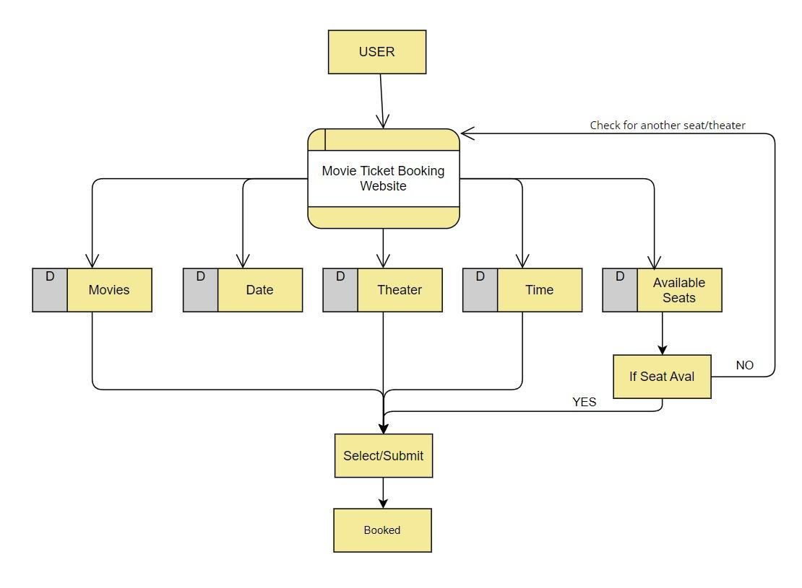
Flow Chart

Slide 5
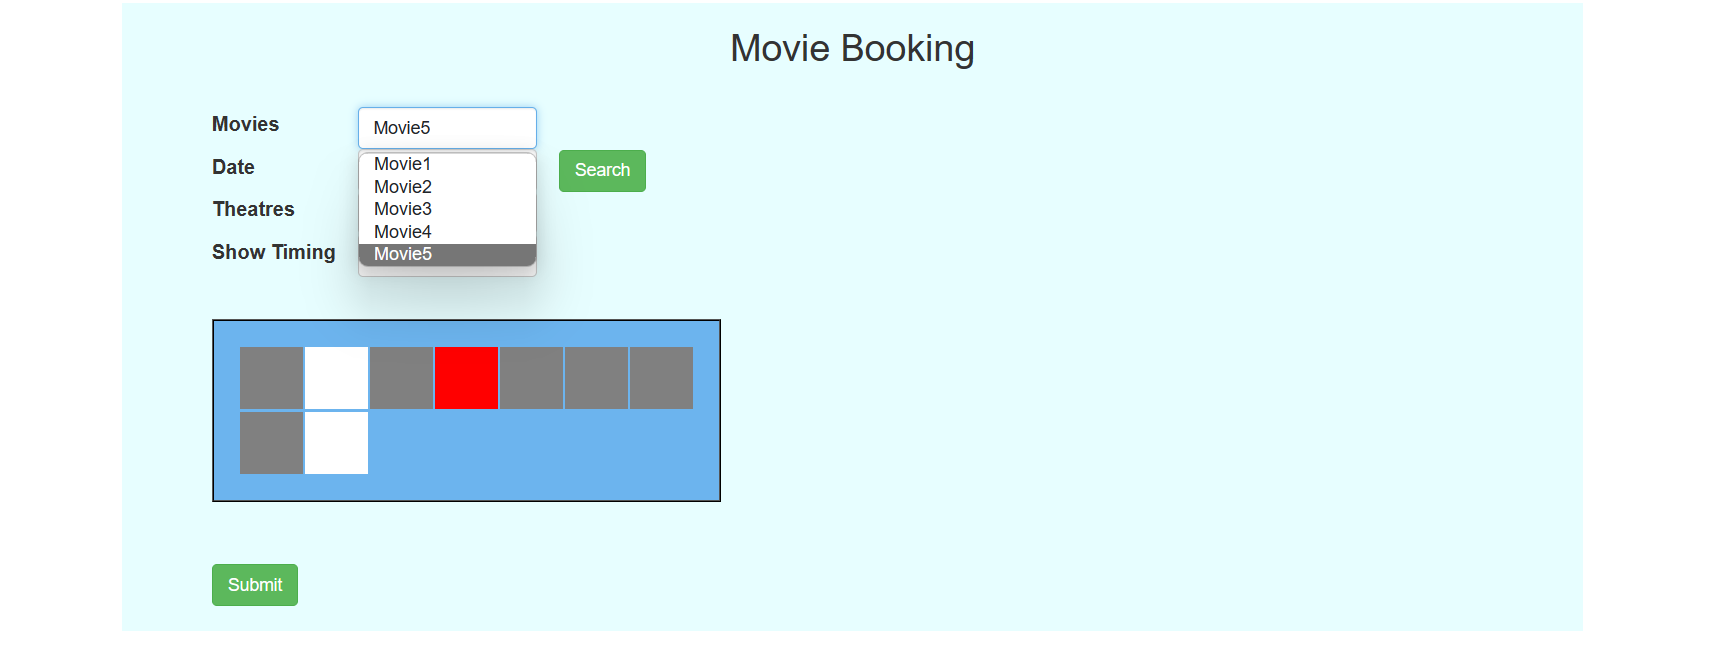

Slide 6
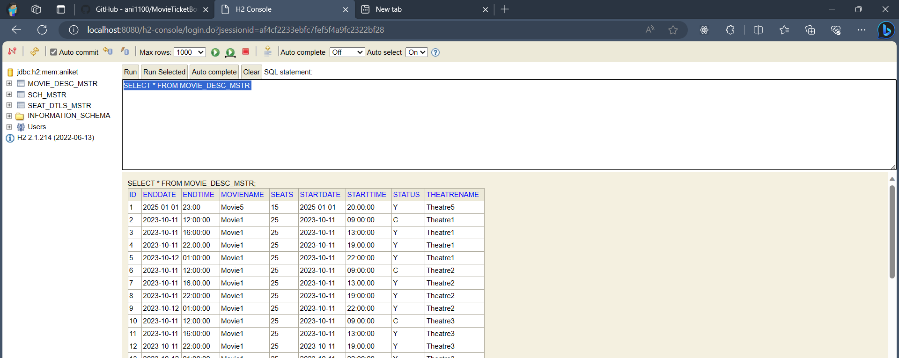

Slide 7
In conclusion, the Java Spring Boot-based CineMates: movie ticket booking is well-structured three-layer architecture ensures efficient data flow, comprising controllers, services, and data access objects (DAOs).
Providing real-time seat reservations, enabling users to select their preferred seats conveniently.
Conclusion

